Slide 1







Slide 2

Simple Online Rental Portal designed to Help you to find all types of rental properties of your dreams…

Slide 3

Contents
Project Statement
Functionalities
Use cases
Technologies
Future Scope
References

Slide 4

Project Statement
Home4U is an application that will provide rental housing to students, corporates and people in need. This is a hassle-free application that will allow users to post new houses and buy posted houses on rent as per their budgets and needs.

Slide 5

Functionalities
Login and Registration
Post Apartments
View Posted Apartments
View Favourite Apartments
Search Apartments by location
Search by applying filters

Slide 6
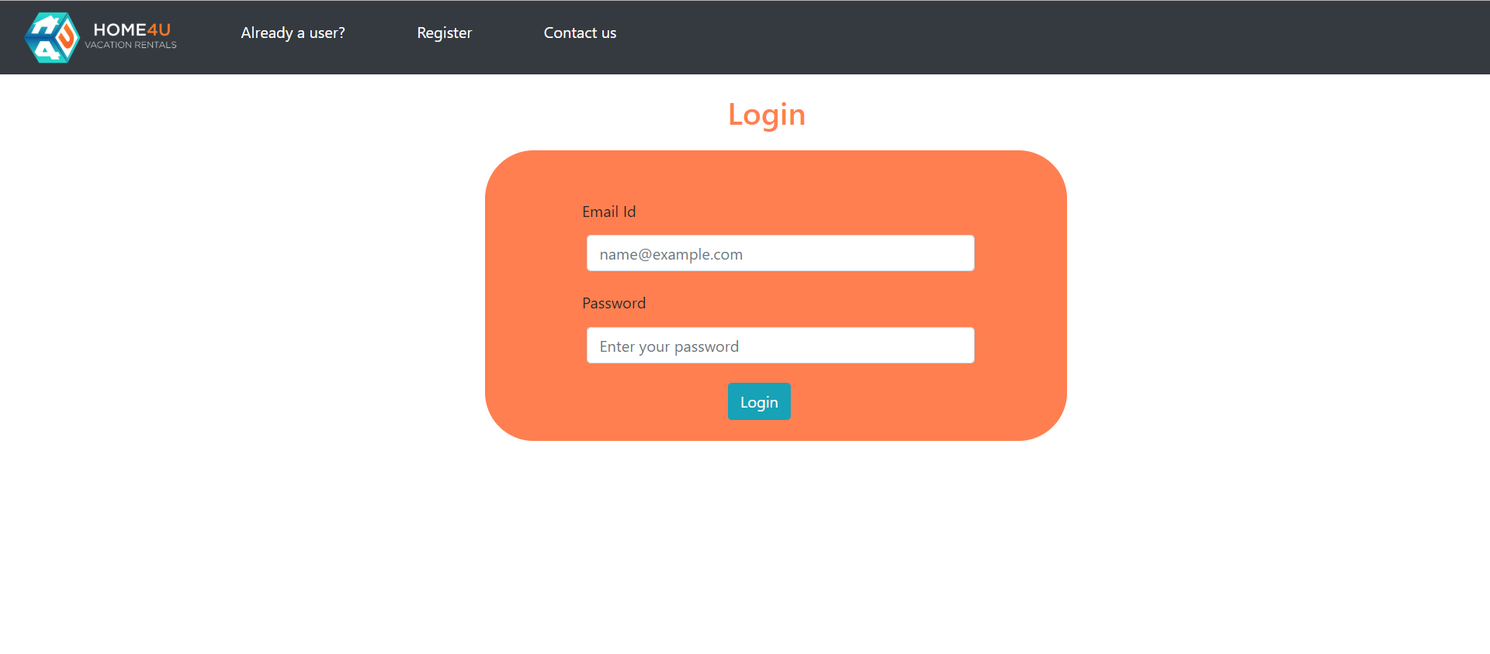
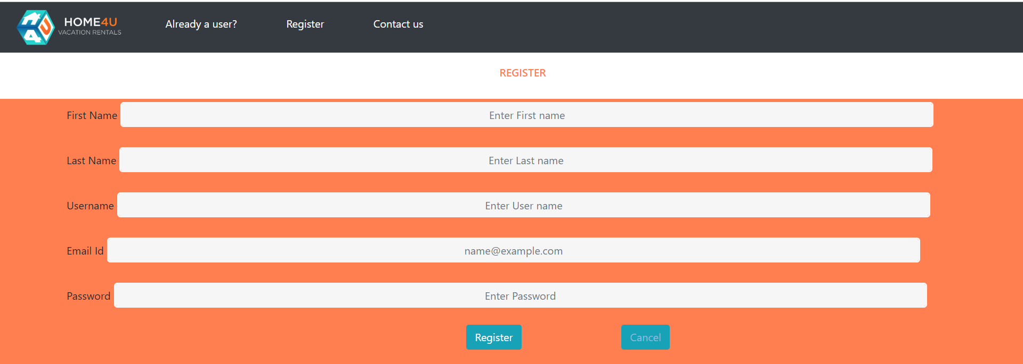
Login & Registration
User is able to Register to the application successfully.
After registering user is able to login for proceeding with the further actions.

Slide 7
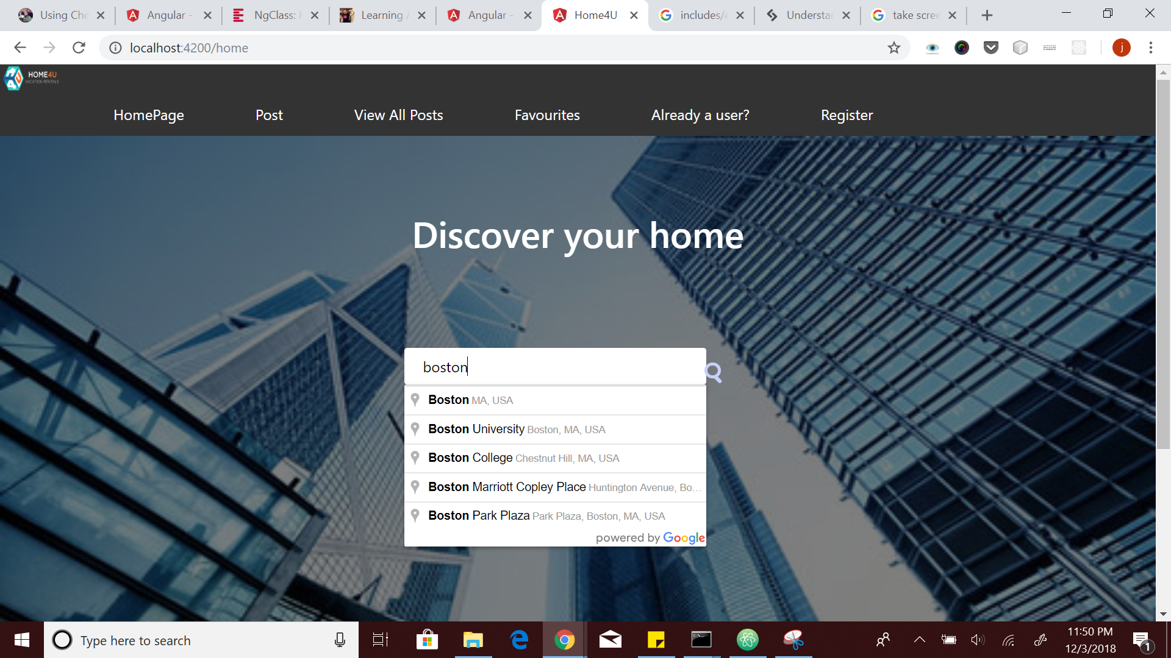
Home Page
User can search via search bar on homepage

Slide 8
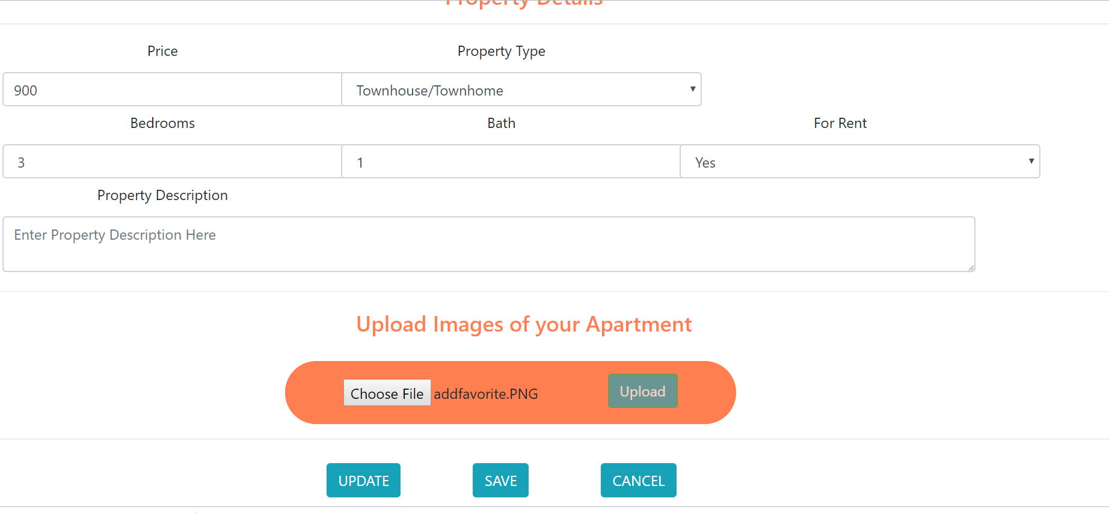
Post Apartments
User is able to Post new apartments.
Property location, property details and user details are specified in this form.
User is able to upload image of the apartment successfully.

Slide 9
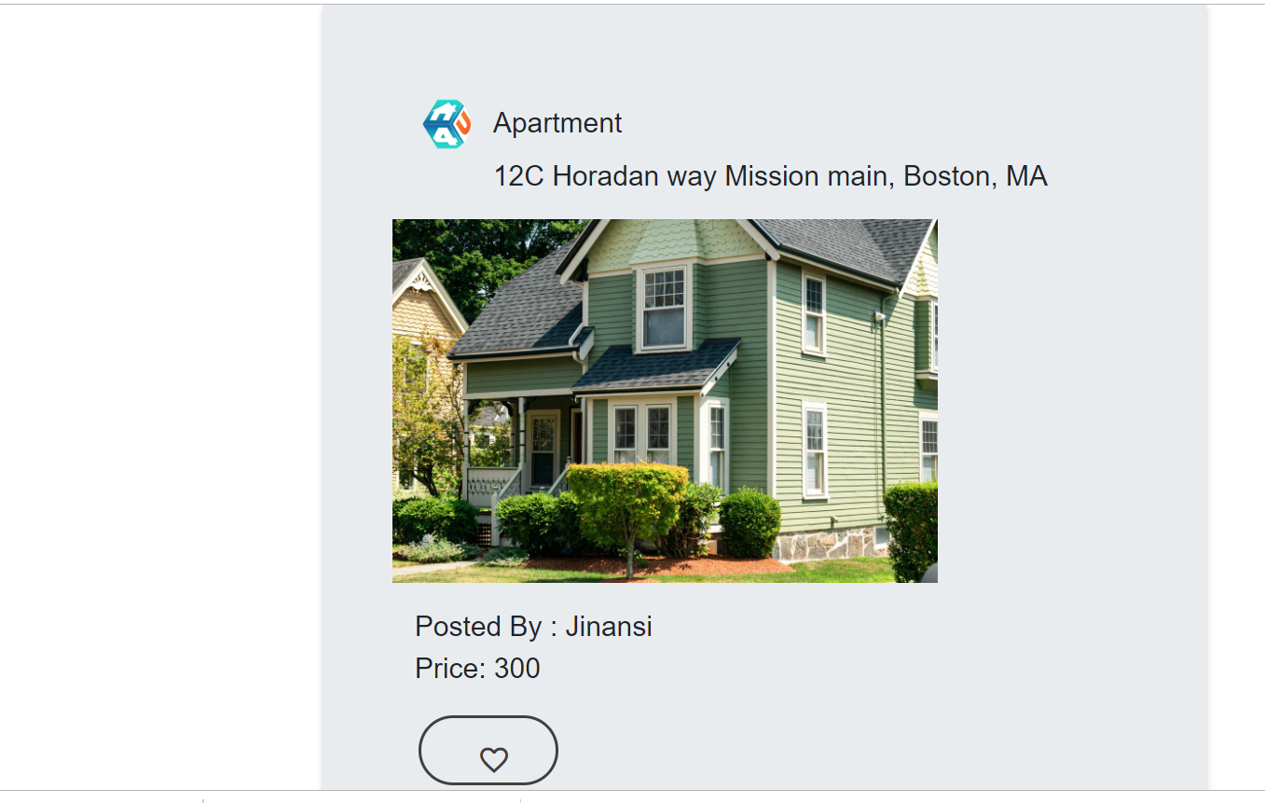
Favorite Screen
User is able to select favorite apartments, view them and see all favorite apartment list.

Slide 10
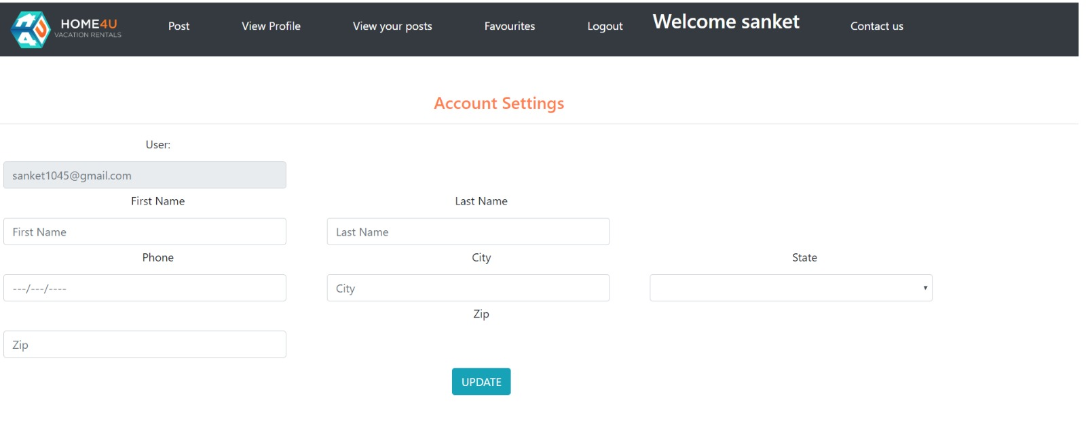
ACCOUNT SETTINGS
User is able to update the account

Slide 11
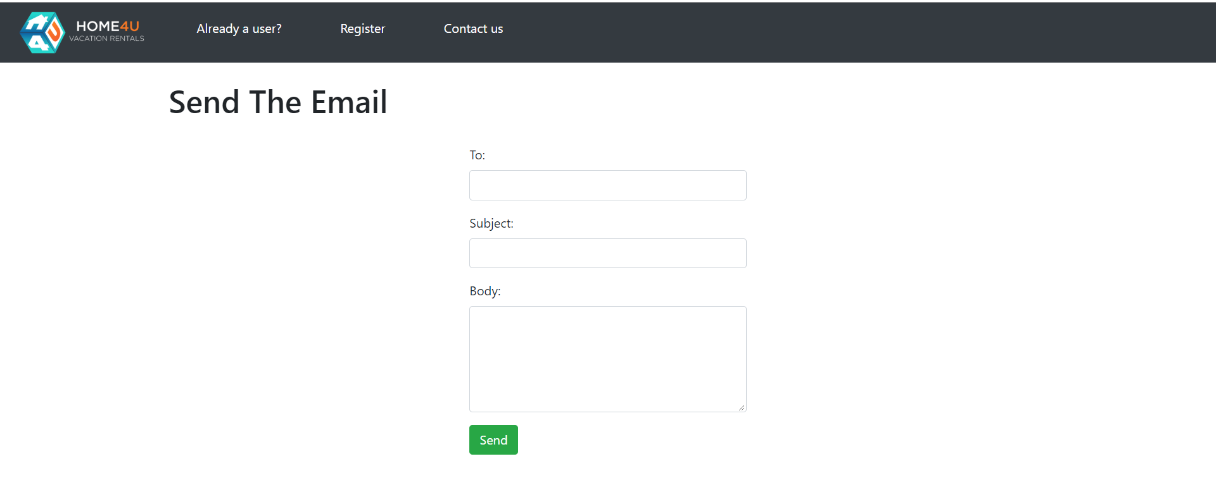
Contact PAGE
User is able to send email successfully

Slide 12

Technologies
Frameworks
MEAN Stack
Packages
1. Frontend
npm install --save @angular/material
npm install --save @angular/animations
npm i -s @angular/material@latest
npm i -s @angular/cdk
npm i --save-dev @types/googlemaps
npm i -s @types/node
npm install @types/node --save-dev
npm install ngx-google-places-autocomplete
npm install rxjs-compat --save
npm install bootstrap --save
npm install ng2-file-upload –save
npm install express multer body-parser --save
npm install nodemon --save-dev
2. Backend
npm install --save-dev babel-cli babel-preset-env
npm install babel-watch --save-dev
npm i -s babel-cli
npm i -s babel-core
npm install express
npm install mongoose
npm install cors
npm install -s socket.ionpm i -s @angular/cdk
npm install -s body-parser
npm i -s babel-core
npm i -s babel-watch
npm install --save bcryptjs
npm i ng2-search-filter –save
npm install jspdf
npm install --save nodemailer express

Slide 13
Future Scope
Show Crime Rates
Implement Chatbot Functionality

Slide 14
References
https://scotch.io/tutorials/angular-file-uploads-with-an-express-backend
https://appdividend.com/2018/05/25/angular-6-file-upload-tutorial
https://www.sitepoint.com/user-authentication-mean-stack/
https://appdividend.com/2017/08/11/send-email-in-node-js/
https://www.djamware.com/post/5b00bb9180aca726dee1fd6d/mean-stack-angular-6-crud-web-application
https://github.com/CodAffection/MEAN-Stack-Login-and-Logout-in-Angular-6-Part-2/tree/master/server

Slide 15




team
Jinansi Thakkar
Anuja THAWALI
Arzoo UZMA
NEHA PANCHAL

Slide 16


Thank you
https://github.com/neu-mis-info6150-fall-2018/final-project-rise

